Slide 1
Aspire – why it matters, what it means
Accessibility statements providing improved reader experiences
Notes:
Aspire – why it matters, what it means
Accessibility statements providing improved reader experiences

Slide 2
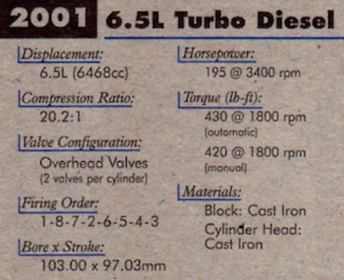
If accessibility statements were car adverts…
Images from https://jalopnik.com/this-old-deck-of-gm-engine-and-transmission-trading-car-1827657205
Notes:
If accessibility statements were car adverts…
Image shows information on a car – giving engine torque, gearbox torque, engine compression ratio etc.
It is meaningless to most people who simply want to know things like “how many miles per gallon will I get?”
Yet many accessibility statements regarding publisher digital products or publisher/aggregator platforms are like this. VPAT statements (voluntary product accessibility templates) are common with US publishers and yet are little more meaningful than these nerdy statements.

Slide 3
But worse than that is this…
Notes:
This is a blank slide. Many publishers and platform providers had no discoverable accessibility information.

Slide 4
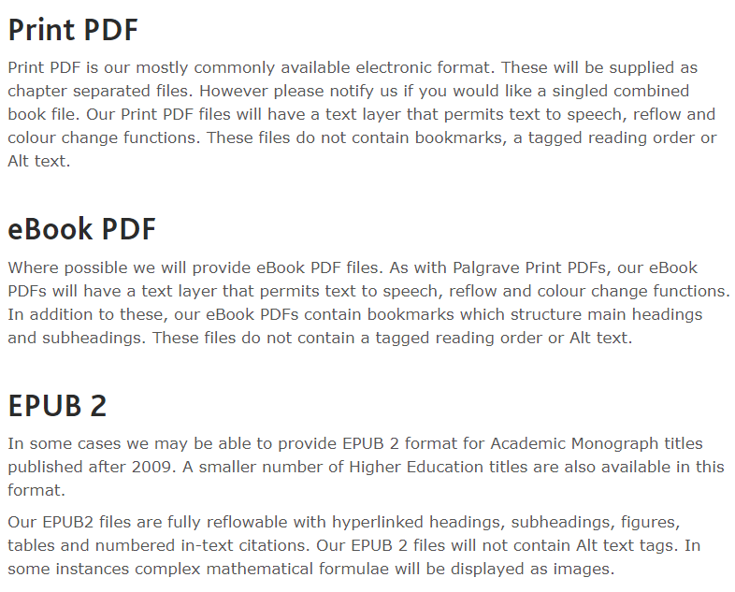
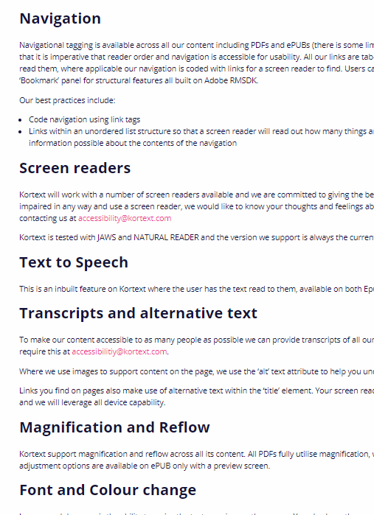
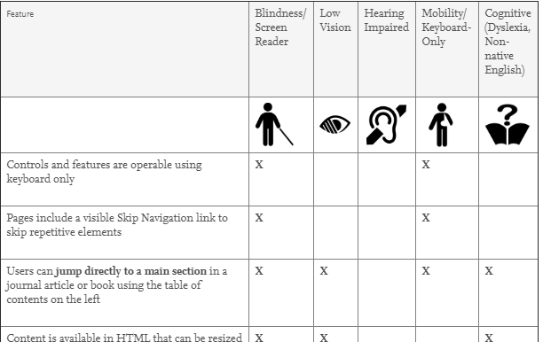
Sample good practices?
Palgrave
Kortext
Elsevier
Notes:
Sample good practices?
Yet some good practices – some very good – did exist. Ther are some samples in the screenshots here – Palgraves’ excellent information on the accessibility of their different formats, Elsevier’s innovative advice according to access needs and Kortext’s thorough and plain English explanation of their product’s features.

Slide 5
Why and for who?
Student
Can I read this comfortably?
Can I read it at all?
How much time will I waste finding out?
Are there useful features I didn’t even think about?
Do I need to ask for an alternative format?
Notes:
Why and for who?
In part this project was about the end user – the student, to help them answer questions like:
Student
Can I read this comfortably?
Can I read it at all?
How much time will I waste finding out?
Are there useful features I didn’t even think about?
Do I need to ask for an alternative format?

Slide 6
Why and for who?
Student
Can I read this comfortably?
Can I read it at all?
How much time will I waste finding out?
Are there useful features I didn’t even think about?
Support staff
Can I advise the student?
Can I give academics reading list guidance?
Do we need to get (or make?) alternative formats?
Will our digital investments cost more than we realised?
… or will they save us money by making learners more self reliant?
Notes:
Why and for who?
It was also to support library staff who need to answer questions like…
Can I advise the student?
Can I give academics reading list guidance?
Do we need to get (or make?) alternative formats?
Will our digital investments cost more than we realised?
… or will they save us money by making learners more self reliant?

Slide 7
Background to the Aspire project - 1
The big questions
Question 1:
What information does a disabled student need to use ebooks confidently and effectively?
Notes:
Background to the Aspire project – 1
The project sought to answer 4 big questions:
Question 1 - What information does a disabled student need to use ebooks confidently and effectively?

Slide 8
Background to the Aspire project - 1
The big questions
Question 1:
What information does a disabled student need to use ebooks confidently and effectively?
Question 2:
Is it realistic for suppliers to provide the information?
Notes:
Question 2 - Is it realistic for suppliers to provide the information?

Slide 9
Background to the Aspire project - 1
The big questions
Question 1:
What information does a disabled student need to use ebooks confidently and effectively?
Question 2:
Is it realistic for suppliers to provide the information?
Question 3:
How easy is it to find when you look for it?
Notes:
Question 3: - How easy is it to find when you look for it?

Slide 10
Background to the Aspire project - 1
The big questions
Question 1:
What information does a disabled student need to use ebooks confidently and effectively?
Question 2:
Is it realistic for suppliers to provide the information?
Question 3:
How easy is it to find when you look for it?
Question 4:
How good is it?
Notes:
Question 4: How good is the information when I finally find it?

Slide 11
Background to the Aspire project - 2
Participants: 146 staff from 49 higher education institutions took part.
Plus a hand full of suppliers
Notes:
Background to the Aspire project - 2
Participants: 146 staff from 49 higher education institutions took part, as well as a few suppliers. The main participants were librarians (74%) with disability support and disability librarian forming the next biggest groups at 11% each

Slide 12
Background to the Aspire project - 3
Cultural context
We all want the same thing: more students reading more books more effectively.
Collaboration is better than conflict: universities and colleges have expertise in the issues for disabled students. Suppliers have expertise in the ‘art of the possible’.
We are all learning: being open to learn improves the quality of what we do – whatever our role.
Notes:
Background to the Aspire project – 2
Cultural context – culture is important because we are attempting to affect cultural change, among suppliers and among universities /colleges.
We all want the same thing: more students reading more books more effectively.
Collaboration is better than conflict: universities and colleges have expertise in the issues for disabled students. Suppliers have expertise in the ‘art of the possible’.
We are all learning: being open to learn improves the quality of what we do – whatever our role.

Slide 13
Background to the Aspire project - 4
Methodology and mode of working
Launch meeting January 2018, sponsored by Publishers Association, hosted by Springer Nature. Publishers, aggregators, library and disability specialists.
Open mailing list and steering group with fortnightly - monthly meetings.
Discussions, decisions etc distributed via email list and editable Google docs.
Agreed survey questions pre-launched to suppliers at London BookFair accessibility seminar, 3 months ahead of audit.
Data collection trialled with open pilot at Kings College London to which librarians & suppliers invited. Online ‘worked walkthrough’ delivered via Jisc.
Audits organised to provide multiple sampling.
Data analysis and reporting opportunities offered to all participants.
Notes:
Background to the Aspire project – 4
Methodology and mode of working
Launch meeting January 2018, sponsored by Publishers Association, hosted by Springer Nature. Publishers, aggregators, library and disability specialists.
Open mailing list and steering group with fortnightly - monthly meetings.
Discussions, decisions etc distributed via email list and editable Google docs.
Agreed survey questions pre-launched to suppliers at London BookFair accessibility seminar, 3 months ahead of audit.
Data collection trialled with open pilot at Kings College London to which librarians & suppliers invited. Online ‘worked walkthrough’ delivered via Jisc.
Audits organised to provide multiple sampling.
Data analysis and reporting opportunities offered to all participants.

Slide 14
Recognising the complexity
Files and formats
Navigation (chapters, headings)
Reflow/magnify.
Colour change.
Text to speech.
Reading order.
Screenreader.
Image description.
PDF
HTML
EPUB
Notes:
Recognising the complexity
The end user’s experience depends on different parts of the supply chain. Some of this complexity is unpacked in this slide and the next 4 :
Files and formats.
The production of files and the choice of formats (PDF, EPUB, HTML) will influence:
Navigation (chapters, headings)
Reflow/magnify.
Colour change.
Text to speech.
Reading order.
Screenreader.
Image description.

Slide 15
Recognising the complexity
Files and formats
Navigation (chapters, headings)
Reflow/magnify.
Colour change.
Text to speech.
Reading order.
Screenreader.
Image description.
PDF
HTML
EPUB
Interfaces
Publisher’s online eg Elsevier Science Direct or Cambridge Online.
Aggregator’s online
eg Kortext, VitalSource.
Reading software
Adobe Digital Editions
Adobe Reader
BlueFire Reader
Web browser
Type
Plugins
Notes:
2) Interfaces through which the formats are delivered:
This can include the
Publisher’s online interface eg Elsevier Science Direct or Cambridge Online.
An Aggregator’s online interface eg Kortext, VitalSource.
The Reading software the product is locked to (or free from)
Adobe Digital Editions
Adobe Reader
BlueFire Reader
Web browser factors including the browser type (Internet Explorer offers no plugins) and the Plugins installed – eg colour changing, text to speech etc.

Slide 16
Recognising the complexity
Files and formats
Navigation (chapters, headings)
Reflow/magnify.
Colour change.
Text to speech.
Reading order.
Screenreader.
Image description.
PDF
HTML
EPUB
Interfaces
Publisher’s online eg Elsevier Science Direct or Cambridge Online.
Aggregator’s online
eg Kortext, VitalSource.
Reading software
Adobe Digital Editions
Adobe Reader
BlueFire Reader
Web browser
Type
Plugins
Institutional IT
Guidance
Software available
Software version
Browser available
Plugins installed
Browser lockdown
Notes:
3) Institutional IT systems and
Guidance available
Software available
Software version
Browsers available (or Browser lockdown)
Plugins installed

Slide 17
Recognising the complexity
Files and formats
Navigation (chapters, headings)
Reflow/magnify.
Colour change.
Text to speech.
Reading order.
Screenreader.
Image description.
PDF
HTML
EPUB
Interfaces
Publisher’s online eg Elsevier Science Direct or Cambridge Online.
Aggregator’s online
eg Kortext, VitalSource.
Reading software
Adobe Digital Editions
Adobe Reader
BlueFire Reader
Web browser
Type
Plugins
Institutional IT
Guidance
Software available
Software version
Browser available
Plugins installed
Browser lockdown
Reader skill
How do I use this?
Which do I choose?
What is possible?
Notes:
4) Reader skill
How do I use this?
Which do I choose?
What is possible?

Slide 18
Recognising the complexity
Files and formats
Navigation (chapters, headings)
Reflow/magnify.
Colour change.
Text to speech.
Reading order.
Screenreader.
Image description.
PDF
HTML
EPUB
Interface/platform
Publisher’s online eg Elsevier Science Direct or Cambridge Online.
Aggregator’s online
eg Kortext, VitalSource.
Reading software
Adobe Digital Editions
Adobe Reader
BlueFire Reader
Web browser
Type
Plugins
Institutional IT
Guidance
Software available
Software version
Browser available
Plugins installed
Browser lockdown
Reader skill
How do I use this?
Which do I choose?
What is possible?
Platform/aggregator questionnaire
Publisher questionnaire
Notes:
Since platform providers /aggregators tend to be responsible for the interfaces and publishers more responsible for the nature and quality of the files, we devised two questionnaires and auditors could sign up for auditing specific platforms, specific publishers or both.

Slide 19
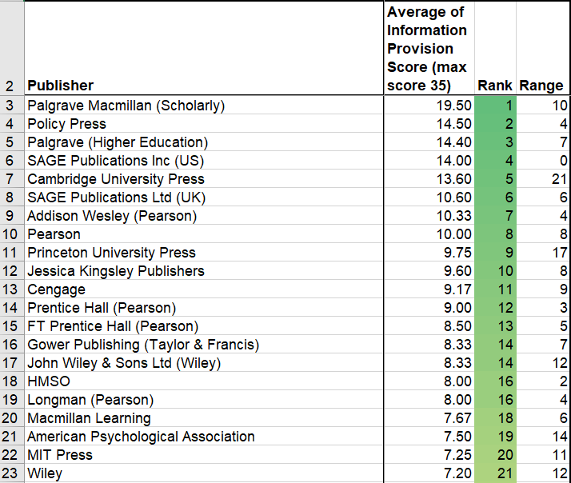
Headline results – publishers
87 publishers audited.
The median score was 3.3 / 35
Considerable range for some suppliers.
Not all criteria scored are necessarily of equal weight - some informative statements may have lost marks for ‘minor’ omissions.
Notes:
Headline results: publishers
87 publishers audited.
The median score was 3.3 / 35
Considerable range for some suppliers.
Not all criteria scored are necessarily of equal weight - some informative statements may have lost marks for ‘minor’ omissions.
Top ten scores were as below:
Palgrave Macmillan (Scholarly) (19.5/35)
Policy Press
Palgrave (Higher Education)
SAGE Publications Inc (US)
Cambridge University Press
SAGE Publications Ltd (UK)
Addison Wesley (Pearson)
Pearson
Princeton University Press
Jessica Kingsley Publishers (9.6/35)

Slide 20
Headline results – platforms/aggregators
54 suppliers audited.
The median score was 5.5 /34
Considerable range for some suppliers.
Not all criteria scored are necessarily of equal weight - some informative statements may have lost marks for ‘minor’ omissions.
Notes:
Headline results – platforms / aggregators
54 suppliers audited.
The median score was 5.5 /34
Considerable range for some suppliers.
Not all criteria scored are necessarily of equal weight - some informative statements may have lost marks for ‘minor’ omissions.
Top ten were (in order)
Kortext (27.7/34)
Vitalsource
EBSCO ebooks
Cambridge Core
Cambridge Companions Online
Ebook Central from Proquest
Elsevier-Science Direct
Alexander Street Press
Askew & Holts (VLE eBooks)
Dawsonera (14.4 / 34)

Slide 21
Relevance for students – Publisher results
How easy is it to find some accessibility information?
58 % of publishers had moderate to good accessibility information.
But can you find the useful bits a disabled reader needs to know?
Scored from 0 – 2. If average is
<0.5 = poor | 0.5 – 1.5 = moderate | >1.5 = good
Notes:
Relevance for students – Publisher results 1
How easy is it to find some accessibility information?
58 % of publishers had moderate to good accessibility information (but Moderate included a score of 0.5 – 1 where 0 is no information and 1 is limited information).
But can you find the useful bits a disabled reader needs to know?

Slide 22
Relevance for students – Publisher results
File ‘heading structure’ influences the ease of navigability by assistive technologies.
This is a plot of average scores per publisher.
Scored from 0 – 2. If average is
<0.5 = poor | 0.5 – 1.5 = moderate | >1.5 = good
Notes:
Relevance for students – Publisher results - 2
File heading structure - influencing the ease of navigability by assistive technologies. Good information was found on 2% of audits, moderate information on 11% and an astonishing 87% had poor information on this – even when their files supported it.

Slide 23
Relevance for students – Publisher results
Magnification and reflow influence the ease with which people using small screens (or those with visual impairment) can read text onscreen.
This is a plot of average scores per publisher.
Scored from 0 – 2. If average is
<0.5 = poor | 0.5 – 1.5 = moderate | >1.5 = good
Notes:
Relevance for students – Publisher results – 3
Magnification and reflow influence the ease with which people using small screens (or those with visual impairment) can read text onscreen.
This is a plot of average scores per publisher.
Good information was available on 4% of audits, 10% had moderate information but 86% were poor.

Slide 24
Relevance for students – Publisher results
Image descriptions (eg Alt Text, Long Descriptions, Captions) influence the accessibility of images for people with poor vision or those who struggle to process images and graphics.
This is a plot of average scores per publisher.
Scored from 0 – 2. If average is
<0.5 = poor | 0.5 – 1.5 = moderate | >1.5 = good
Notes:
Relevance for students – Publisher results – 4
Image descriptions (eg Alt Text, Long Descriptions, Captions) influence the accessibility of images for people with poor vision or those who struggle to process images and graphics.
This is a plot of average scores per publisher. 2% had good information, 15% moderate information but 83% were poor.

Slide 25
Conclusion – publishers & disabled readers
2% of publishers had good information on image description and navigability features.
3% provided good information on magnification and reflow.
Many produce files where these accessibility features are provided, but information is difficult/impossible to find.
This puts a burden of trial and error on …. who?
Notes:
Conclusion – publishers
2% of publishers had good information on image description and navigability features.
3% provided good information on magnification and reflow.
Many produce files where these accessibility features are provided, but information is difficult/impossible to find.
This puts a burden of trial and error on …. who?

Slide 26
Relevance for students – Platform results
Discoverability of accessibility information = moderate to good in 76% of platforms.
We only audited the ‘read online’ option.
Fewer variables compared to publishers with multiple formats, legacy content etc.
Scored from 0 – 2. If average is
<0.5 = poor | 0.5 – 1.5 = moderate | >1.5 = good
Notes:
Relevance for students – Platform results – 1
Discoverability of accessibility information = moderate to good in 76% of platforms.
We only audited the ‘read online’ option.
This meant platform providers had fewer variables that we reported on compared to publishers (who cope with multiple formats, legacy content etc).
29% had good discoverability with 47% moderate and 24% poor.

Slide 27
Relevance for students – Platform results
Navigation information of some sort was available in 50%+ of suppliers audited.
Scored from 0 – 2. If average is
<0.5 = poor | 0.5 – 1.5 = moderate | >1.5 = good
Notes:
Relevance for students – Platform results – 2
Navigation information of some sort was available in 50%+ of suppliers audited, with 16% good, 34% moderate and 50% poor.

Slide 28
Relevance for students – Platform results
Although image descriptions are supplied by publishers we wanted to know if they were ‘relayed’ onto the online reading platform.
Scored from 0 – 2. If average is
<0.5 = poor | 0.5 – 1.5 = moderate | >1.5 = good
Notes:
Relevance for students – Platform results – 3
Although image descriptions are supplied by publishers we wanted to know if they were ‘relayed’ onto the online reading platform so that users choosing the “read online” option could still access them.
.
There was good information on image descriptions on 4% of audited platforms. 29% had moderately useful information but 67% were poor.

Slide 29
Relevance for students – Platform results
Visual appearance
Scored from 0 – 2. If average is
<0.5 = poor | 0.5 – 1.5 = moderate | >1.5 = good
Notes:
Relevance for students – Platform results – 4
Two key elements of visual appearance include the ability to magnify text without having to scroll left and right to read it. Text that reflows to fit the page is much more accessible. Magnification needs to be of sufficient extent to be useful (ideally around 25 – 30 point equivalent) and to reflow.
There was good information on magnification on 14% of platforms, moderate on 34% and poor on 52%.
Similarly, visually impaored and dyslexic students may need to change colour contrast. We found good informationon this on 15% of platforms. 28% of platforms had moderately useful mentions and 57% poor information.

Slide 30
Relevance for students – Platform results
Audio options
Scored from 0 – 2. If average is
<0.5 = poor | 0.5 – 1.5 = moderate | >1.5 = good
Notes:
Relevance for students – Platform results – 5
Audio options are about whether the text can be read aloud by text to speech tools or screenreaders (very different technologies serving very different access needs). Some platforms will have text to speech built in (which can help get around DRM issues with download limits) but even if they don’t have it built in, the text should be ‘exposed’ to appropriate assistive technologies.
We found screenreader information was good for 24% of sampled platforms, moderate for 33% and poor for 43%.
Text to speech information was good for 14% of platforms, moderate for 26% but poor for 60%.

Slide 31
Conclusion – platforms & disabled readers
Scores were generally higher BUT the task is potentially less challenging :
One product (the interface)
Total control on interface design with fewer legacy issues
Too many case of absent information.
Many missed opportunities (eg browser plugin advice)
This puts a burden of trial and error on …. who?
Notes:
Conclusion – platforms & disabled readers
Scores were generally higher for platforms BUT the task is potentially less challenging because we they are reporting on:
One product (the interface)
Total control on interface design with fewer legacy issues
There were still too many case of absent information – it is almost as if disabled students do not exist in the minds of marketing personnel.
There were many missed opportunities to improve the user experience using third party recommendations (eg browser plugin advice)
As we say with publishers, the lack of information puts a burden of trial and error on …. either the library staff or the student themselves.

Slide 32
Library stories – Formats & recommendations
Different formats have different accessibility ‘profiles’.
These may vary with the reading tool. You need advice to pass on to users.
Analysis by Jessica Wykes, City University of London
Notes:
Library stories: formats and recommendations.
Different formats have different accessibility ‘profiles’.
These may vary with the reading tool. You need advice to pass on to users but the information is in short supply.
Publishers and platform providers were uniformly poor at providing useful information on the benefits of different formats or reading options. 2% of publishers and 4% of platform providers scored as Good while 69 and 70% respectively scored as poor.
Obtaining an alternative format is usually the route a librarian will take if the ebook is inaccessible to the student they are supporting. There may be instances where commercial ebooks cannot meet a student’s needs. Obtaining or making alternative formats can be an expensive and time consuming process. It costs on average £0.96 per page to source and adapt alternative format materials. Relationships with national repositories such as RNIB Bookshare are very important for academic libraries and have become part of their accessible formats workflow. Once a librarian in one institution requests a text which is uploaded to the site, it can then be downloaded by multiple institutions for multiple students significantly reducing fulfilment times.
Ben Watson University of Kent eBook Accessibility Audit, ALISS December 2016 Available at https://www.slideshare.net/heatherdawson/the-ebook-assessibility-audit

Slide 33
Library stories – DRM options & anticipation
Digital Rights Management software protects IPR.
It can creates barriers for disabled users.
Knowing the DRM status of a collection allows you to anticipate problems.
Analysis by Jessica Wykes, City University of London
Notes:
Library stories: DRM and anticipation
Digital Rights Management software protects IPR.
It can creates barriers for disabled users.
We did not score suppliers on whether they applied DRM – that’s a commercial decision – but on whether they provided the information that would allow library staff to anticipate problems and prioritise solutions.
This information was in very short supply – 2% of publishers and 0% of aggregators scored as Good. Platform providers scored better in the Moderate category (29% compared to 11% for publishers but a huge majority were in the Poor category (87% publishers, 71% aggregators).

Slide 34
Library stories – accessibility services
Many publishers work directly with other accessibility organisations.
If you have the information you can
prioritise student requests and
let some students self-serve their accessibility needs.
Analysis by Jessica Wykes, City University of London
Notes:
Library stories: accessibility services
Many publishers work directly with other accessibility organisations such as RNIB Bookshare, Bookshare or AccessText in the US.
If librarians have this information they can
prioritise student requests and
let some students self-serve their own accessibility needs (for example RNIB bookshare allows you to set up accounts for individual students).

Slide 35
What happens next – your role?
Look at your supplier scores on the Dashboard tabs on the downloadable spreadsheet. How vulnerable are you when it comes to advising disabled students?
Ask your supplier contacts to check their own scores and let you know if they need advice on improving.
Tell your supplier contacts about Jisc’s online training for suppliers on improving ebook accessibility statements.
Many suppliers undersell their accessibility. Make the most of what works – liaise with colleagues in disability services and study support to identify how to improve student skills and expectations in exploiting ebook accessibility.
Notes:
What happens next – your role?
Look at your supplier scores on the Dashboard tabs on the downloadable spreadsheet. How vulnerable are you when it comes to advising disabled students?
Ask your supplier contacts to check their own scores and let you know if they need advice on improving.
Tell your supplier contacts about Jisc’s online training for suppliers on improving ebook accessibility statements.
Many suppliers undersell their accessibility. Make the most of what works – liaise with colleagues in disability services and study support to identify how to improve student skills and expectations in exploiting ebook accessibility.

Slide 36
What happens next – our role?
Providing Jisc training session for suppliers on making the most of the Aspire results.
Recognising best current performers and (in the New Year) most improved.
Series of interpretative articles ready to drip feed onto the Aspire website to keep the momentum going.
We will be reporting back to the Publishers Association, Publishers Licensing Society and CLA through meetings, events or news articles.
Contributing to conferences and journal articles.
The data is openly available for others to use for research or benchmarking.
Notes:
What happens next – our role?
Providing Jisc training session for suppliers on making the most of the Aspire results.
Recognising best current performers and (in the New Year) most improved.
Series of interpretative articles ready to drip feed onto the Aspire website to keep the momentum going.
We will be reporting back to the Publishers Association, Publishers Licensing Society and CLA through meetings, events or news articles.
Contributing to conferences and journal articles.
The data is openly available for others to use for research or benchmarking.

Slide 37
The evidence base
Platform / aggregators: 243 audits were conducted on 54 different platforms, an average of 4.5 audits per platform.
Publishers: 342 audits were conducted on 87 publishers, an average of 3.9 audits per publisher.
Institutions and individuals: – 49 Higher education (HE) institutions took part, 2 aggregators (Kortext and ProQuest), plus one other who didn’t provide an institutional email.
The seven most prolific HE university libraries were as follows (number of audits in brackets):
City, University of London (92), Leeds Beckett (50), Open University (48), Swansea (43) Sheffield Hallum University (31), Leeds and Huddersfield – (27 each).
Notes:
The evidence base
Platform / aggregators: 243 audits were conducted on 54 different platforms, an average of 4.5 audits per platform.
Publishers: 342 audits were conducted on 87 publishers, an average of 3.9 audits per publisher.
Institutions and individuals: – 49 Higher education (HE) institutions took part, 2 aggregators (Kortext and ProQuest), plus one other who didn’t provide an institutional email.
The seven most prolific HE university libraries were as follows (number of audits in brackets):
City, University of London (92), Leeds Beckett (50), Open University (48), Swansea (43) Sheffield Hallum University (31), Leeds and Huddersfield – (27 each).

Slide 38
Particular thanks
Publishers Association and Springer Nature in getting us started.
London bookfair and Publishers Licensing Society for support with making the project public.
Everyone contributing to the steering group, especially suppliers.
Kings College London and the University of Liverpool for pilots.
Huw Alexander (Sage / textBOX) for advice and an amazing database of accessibility urls.
Data divas and story tellers (Susan Smith, Jamie Phillips, Ben Watson, David Clover, Jessica Wykes, Huw Alexander, Gopal Dutta, Annette Moore)
Kat Bradley, Dita Krauzer and James Atkinson who covered 101 audits.
Jisc for facilitation support and the Jiscmail service.

Slide 39
Further links and actions
Aspire website – http://tiny.cc/aspire2018
Jisc online training for publishers https://www.jisc.ac.uk/training/e-book-accessibility
Jisc Accessibility support for HE and FE
Finding publisher accessibility information - https://www.textboxdigital.com/searchboxhome
Notes:
Aspire website – http://tiny.cc/aspire2018
Jisc online training for publishers https://www.jisc.ac.uk/training/e-book-accessibility
Jisc Accessibility support for HE and FE

