Slide 1
Quo vadis?
Getting there with linked data
Gordon Dunsire
UKSG webinar, 5 July 2016

Slide 2
Overview
A basic introduction to data structures: triples, chains, and clusters
What is a linked data record?
Global, multilingual linked data
Linking data from multiple sources
The Semantic Web: a paradigm shift?

Slide 3
Semantic Web (of linked data)
“machine-readable metadata”
  Faster! 24/7/365! Global!
Metadata expressed as “atomic” statements
  A simple, single, syntactically irreducible statement
    The title of this book is “Treasure island”
In a standard machine-processable format
  Resource Description Framework (RDF)

Slide 4
Resource Description Framework
Metadata statement constructed in 3 parts
  “Triple”
The title of this book is “Treasure island”
  Subject of the statement = Subject: This book
  Nature of the statement = Predicate: has title
  Value of the statement = Object: “Treasure island”
This book – has title – “Treasure island”
  subject – predicate - object

Slide 5
Identifiers
Need unambiguous way of identifying each part of the triple for efficient machine-processing
  Human labels (“This book”, “has title”) no good
    Same thing, different labels; different things, same label
Exploit the utility of the URL
  Machine-readable, regular syntax, unambiguous
Uniform Resource Identifier (URI)

Slide 6
RDF rules
Human-readable data are the values of triple statements stored as text
  "Treasure Island"
  Character string = "literal"
A triple object may be a literal value
Everything else is a URI
  A triple object may be a URI
  A triple subject must be a URI
  A triple predicate (property) must be a URI

Slide 7
RDF graphs
Triple 1
ex:M1 rdam:P30088 "[United States?]"
Triple 2
ex:M1 rdam:P30001 rdact:1049
… Triple 70 (average number for describing a resource)
subject
URI
property URI
"object literal"
subject
URI
property URI
object
URI

Slide 8
Merged nodes: Clusters and chains
p:z
object3
property:x
"a literal"
subject1
object2
property:y
"another literal"
subject3
p:a
thing4
p:aa
thing5
p:ab
"any literal"

Slide 9
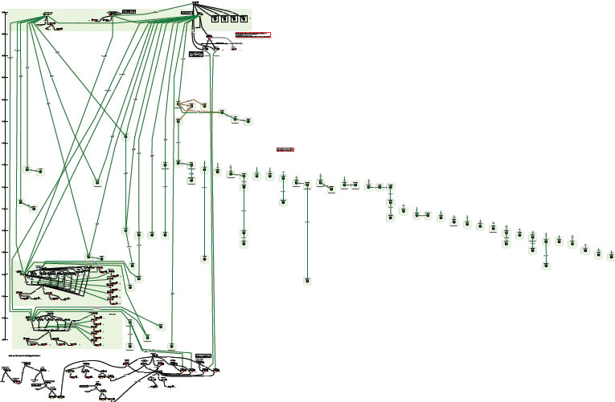
Complexity of relationships: Moby Dick
Diagram using FRBR entities and relationships
Printed editions
“OrsonWhales” mash-up (YouTube)
Ronald J. Murray: From Moby Dick to mash-ups
http://www.slideshare.net/RonMurray/from-mobydick-to-mashups
Notes:
RDA data is designed to reflect the complexity of relationships found in library and cultural heritage resources.
This is an example of a paper exercise to draw the relationships between the various printed editions of Herman Melville’s novel “Moby Dick”.
The complex sub-graph at the bottom represents a multimedia mash-up of Moby Dick with Orson Welles (who acted in the film of Moby Dick).
This diagram can be readily extended.
We could add the film starring Gregory Peck as Captain Ahab, and other film and tv adaptations, in multiple formats and editions. And the various recordings of the instrumental “Moby Dick” (for solo drummer!) by Led Zeppelin, and all the other recordings by the group, in multiple formats and editions. And so on.

Slide 10
Manuscript example: RDF graph
Parchment
material
“Requires ...”
treatment
title
This ms
“Ode to himself”
location
author
Place X
birthplace
Ben Jonson
coordinates
“abcxyz”
“Jonson, Ben”
normalised name
Notes:
RDF triples can be linked by chaining the object (secondary focus) of one triple to the subject (primary focus) of another triple by matching URIs. Triples can also be linked in clusters sharing the same primary focus.
Human-readable strings, enclosed in boxes, cannot be linked because they are not URIs. The literal objects of some triples therefore terminate chains of linked triples.
This is a small RDF graph about:
a manuscript,
Ben Jonson,
parchment,
Place X,
depending on your point of view (or primary focus).
It is part of what has been called the “one giant global graph” that potentially links all resources, and data about them, together. This graph has no centre, edge, up, or down; it is all about what is in focus (the “subject” of a triple).

Slide 11
RDA Manifestation linked data graph
"Concerto for violin and chamber music"
Expression:1
"Margaret Brouwer"
rdam:P30139
"Brouwer New Music Publishing"
Manifestation:1
"[United States?]"
"2004"
"42 cm"
rdam:P30135
Work:1
rdact:1049
"volume"@en
rdamt:1007
"unmediated"@en
rdami:1001
"single unit"@en

Slide 12
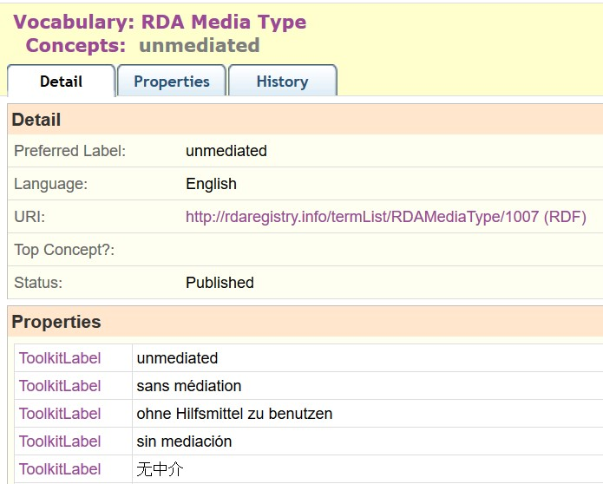
RDA Registry for linked data in Open Metadata Registry

Slide 13
Multilingual linked data
"ohne Hilfsmittel zu benutzen"@de
"sin mediación"@es
rdamt:1007
hasLabel
"unmediated"@en
"sans médiation"@fr
"无中介"@zh

Slide 14
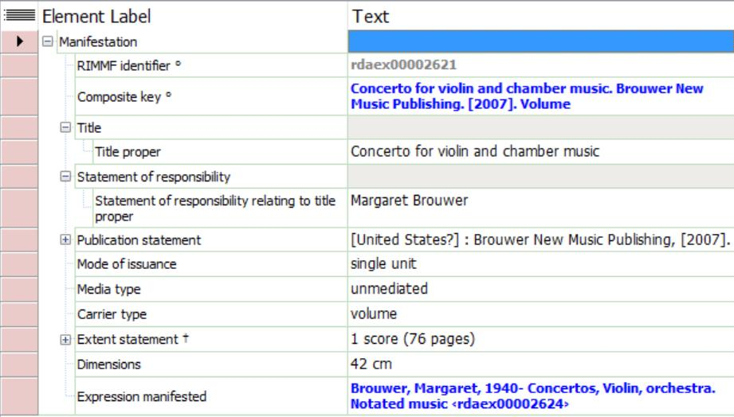
RIMMF linked data display in English

Slide 15
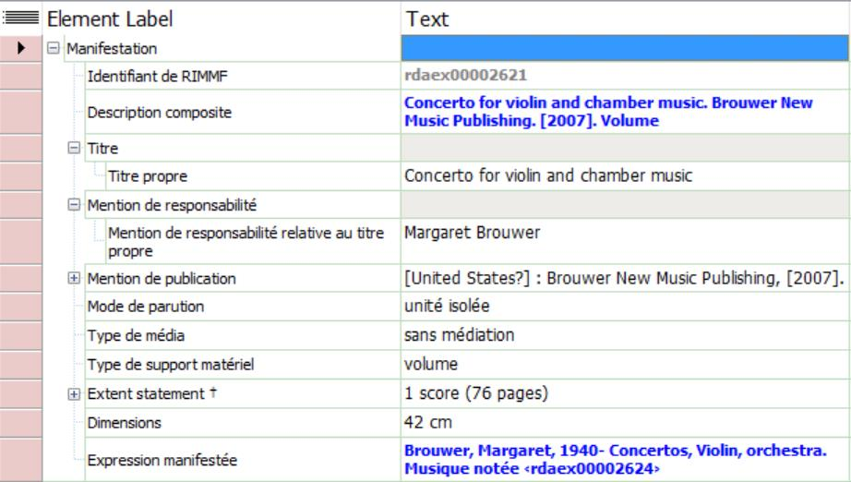
Same RIMMF linked data in French

Slide 16
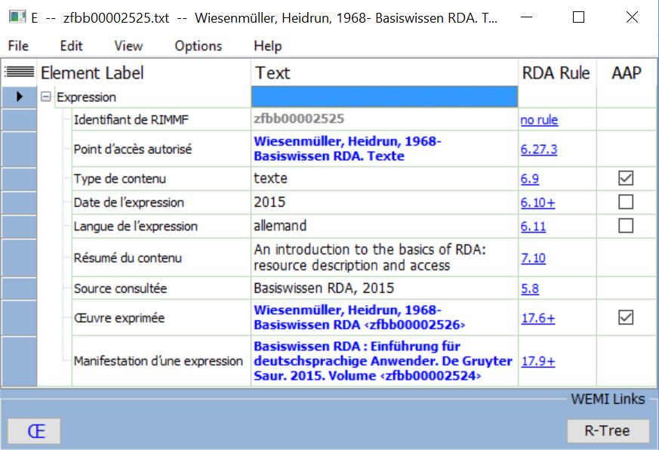
Polylingual data (RIMMF-ball)
French cataloguer
German content
English agency

Slide 17
RDA Agent linked data cluster
rdaa:P50094
"Brouwer, Margaret, 1940-"
rdaa:P50103
"Margaret Brouwer"
Agent:1
"Brouwer, Margaret"
rdaa:P50117
"1940"
rdaa:P50121
match
dbPedia:
Margaret_Brouwer
viaf:
Margaret_Brouwer
match

Slide 18
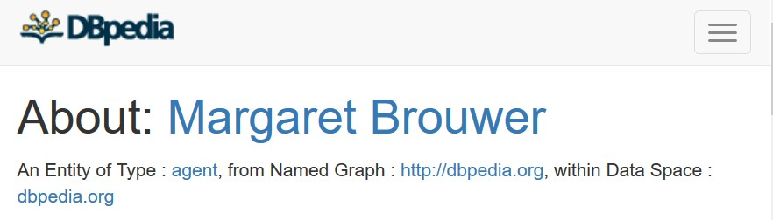
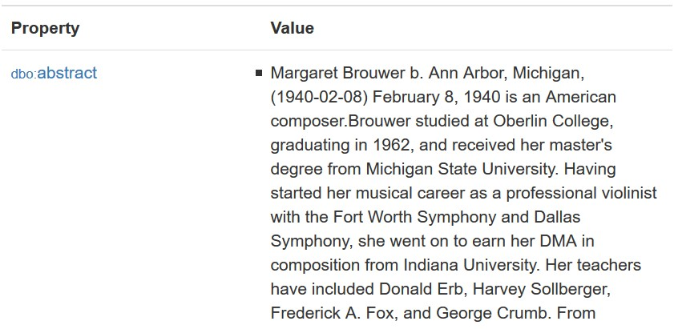
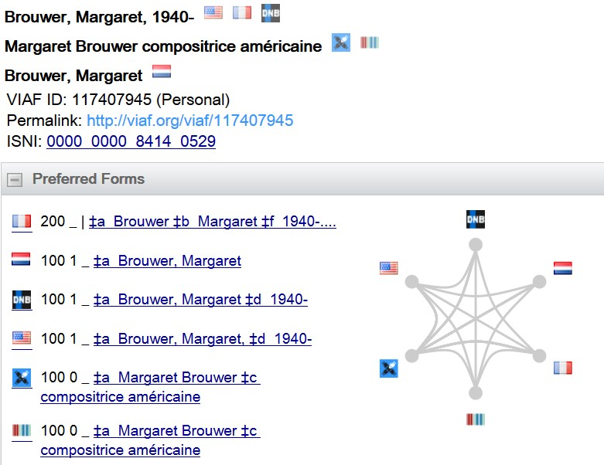

Identifier management:
Match or no match?

Slide 19
Does BIBFRAME fit here?
Semantic map of manifestation carrier/media type
element
dc:
format
dct:
format
schema:
encoding
Broad/
coarse
rdau:
P60050
m21:
M338__b
rdam:
P30002
isbd:
P1003
rdam:
P30001
Narrow/
fine

Slide 20
Semantic Web
Open World Assumption
Absence of data is not data of absence
"Record" is never complete
Linked open data
Semantic data: properties of properties
(triples about properties)
Provenance data: properties of triples
(triples about triples)
Anyone can say Anything about Any thing

Slide 21
Paradigm shift?
No absolute "record"
(just data)
No test for truth
(just inconsistency)
The wisdom of the crowd
(Ask the audience)
The power of the cloud
(Linked data everywhere)
Library and cultural heritage data of highest quality

Slide 22
Thank you
rscchair@rdatoolkit.org
Open Metadata Registry (IFLA, RDA)
  http://metadataregistry.org/
RDA Registry
  http://www.rdaregistry.info/
RIMMF and r-balls (RDA linked data examples)
  http://rballs.info/

