Slide 1
Redefining the Institutional Repository
Chris Keene
Notes:
Note: notes were added to presentation after the talk.
http://www.uksg.org/institutionalrepository
Institutional Repositories have grown in importance over the last 10 years to offer a core University and Library service, however, their role is developing faster now than it has ever done. Funder Open Access requirements, internal reporting, research data. Ref2020 and more are increasing the demands on the traditional repository, putting pressure on staff resources and challenging the underlying software.
This webinar will outline these issues as well as look at how the needs and use of repositories may change in the future.
Date: Thursday 27 November 2014
Time: 1300 GMT
Duration: 45 minutes including Q&A (up to 60 minutes maximum if there is sufficient demand for an extended Q&A)
SPEAKER:
Chris Keene, Technical Development Manager, University of Sussex Library

Slide 2
Chapter one : A brief history of the institutional repository
What; that name; how; software; beginnings; early problems
Chapter two : the publication store
Chapter three : the haves and the have nots
Chapter four: funders, mandates and compliance
RCUK, Horizon 2020, Wellcome/COAF, Post-2104 REF; data; the challenges
Chapter five: help on the horizon

Slide 3
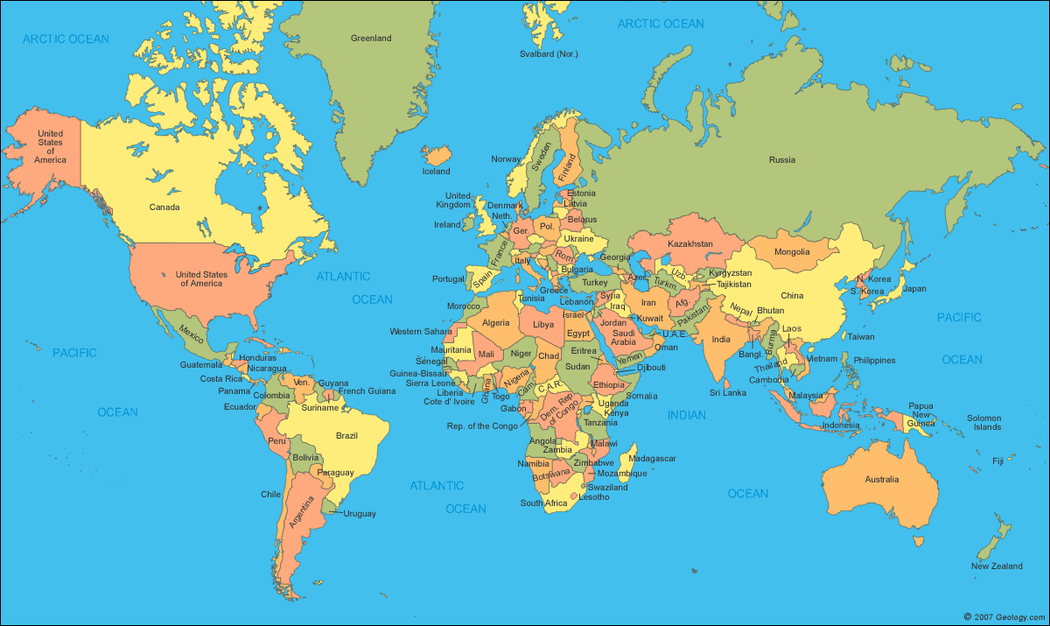
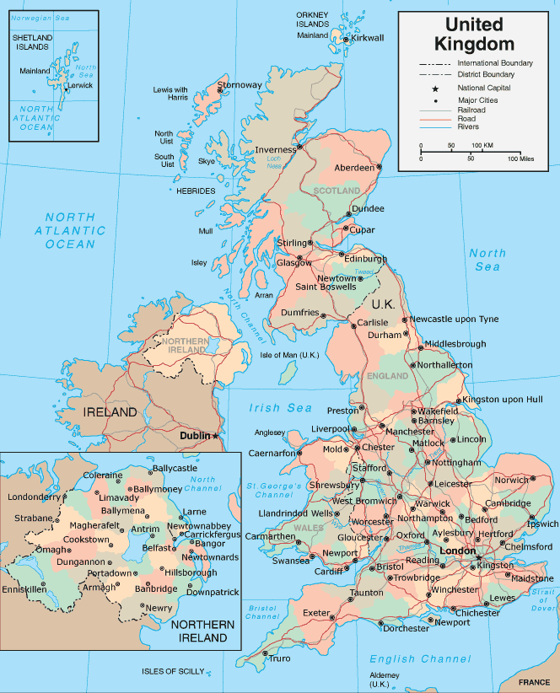
Disclaimer
Notes:
UK focus, as the politics and requirements of each country vary.
Will occasionally talk about just Sussex, where I’m based.

Slide 4
Chapter one : A brief history of the institutional repository

Slide 5
What is an institutional repository?
“A University’s Research Outputs freely available on the web” - me

Slide 6
What does it involve?
Someone has to add each research output to the IR.
Depending who the above, someone will need to check the copyright of the full text output, and check the metadata.
Notes:
I won't dwell on the technical elements, they’re not particularly important. The issue instead was one of awareness and engagement.
However I will give a brief outline of what is involved in adding items to an IR, particularly for those who have never used one.
Items are normally added by the academic, or their assistant, or someone in the library. It will vary from University to University. For example, here at Sussex we don’t add records in the Library, except for theses. So it’s down to the researcher, or someone in their School who can support them.
Once submitted, someone in the library will check the metadata and copyright and make the record live. For a journal article, checking the copyright involves checking SHERPA Romeo. Technically, the source of truth is the CTA (copyright transfer agreement) the academic signs with the publisher, but as the University almost certainly doesn’t have access to it we rely on SHERPA Romeo to provide a generic version of the CTA for that publisher. For conferences and book chapters, it is a whole lot more complex. Those with the luxury of staff time may choose to write to the publisher.
Once the metadata is checked and any uploaded file is given restricted access if copyright dictates, the record can become live. Most software by default locks the record at this point, which can be a source of irritation to academics who take offense that they can’t edit the records of their own outputs, something which I can understand.

Slide 7
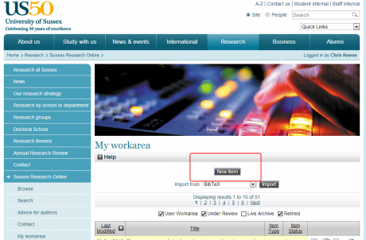
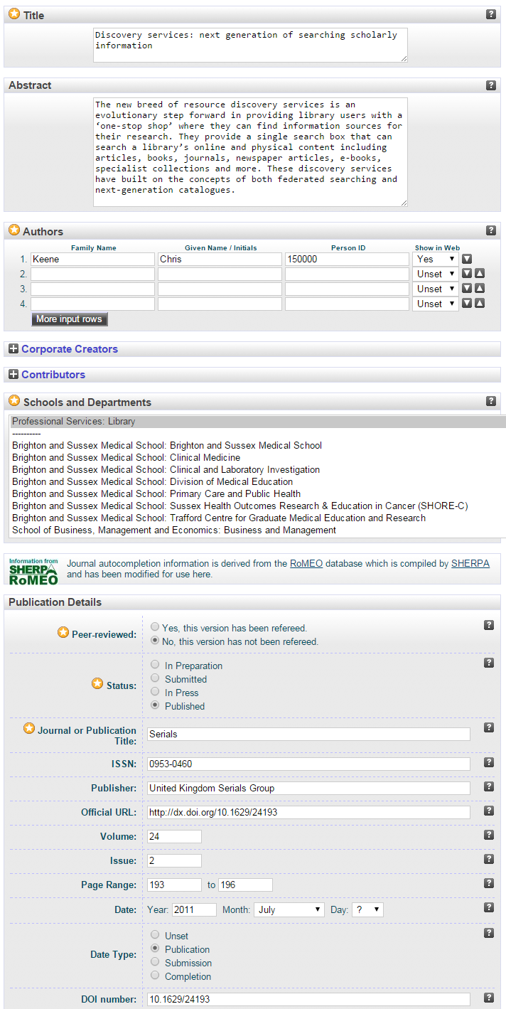
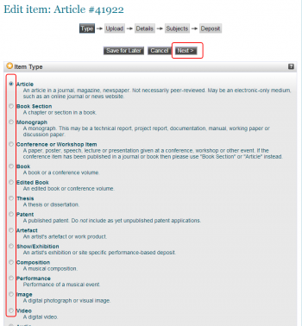
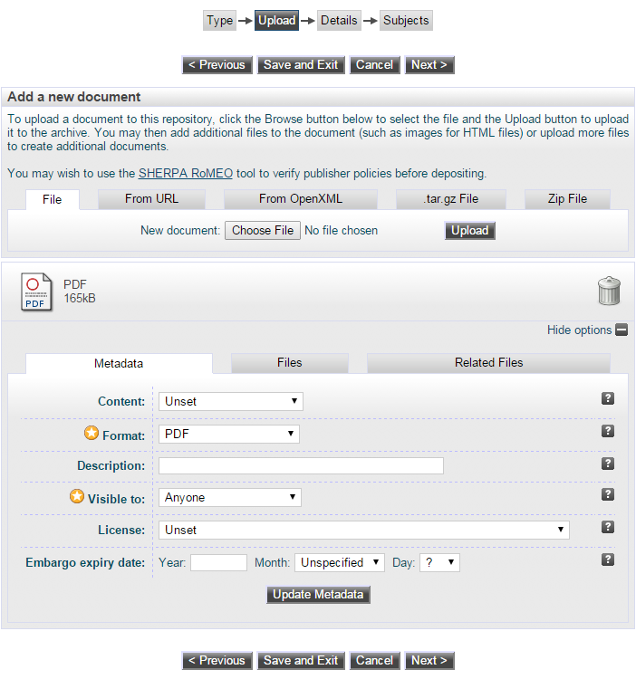

Slide 8
Notes:
In the UK, the most popular software package is Eprints, followed by Dspace, Fedora and a handful of others.

Slide 9
A brief history
2001 : Budapest Open Access Initiative
2007 : general adoption of IRs
Notes:
I’m not going to give a full blown history, but will focus on two dates. The first is 2001, the date of the Budapest Open Access Initiative, which resulted in a statement of OA principles. In 2002 this was opened up for others to sign. Software was developed and made available around this (Eprints 1999, Dspace 2002, Fedora 2003) and early adopters launched a repository.
By 2007 many Universities had an IR, including most which describe themselves as Research Intensive.

Slide 10
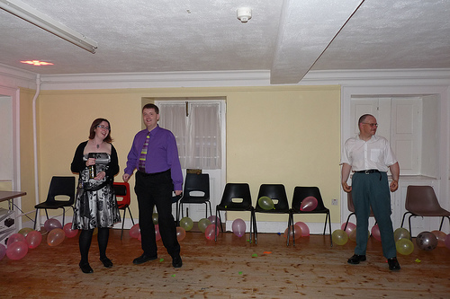
Problem Opportunity : Engagement
Notes:
On the face of it, adding a research output to an IR was a no brainer.
(thanks to the librarian who agreed I could use this photo of them!)

Slide 11
Engagement
Win win?
Notes:
A win win for all.
Academics got increased exposure of their work, a greater chance of being read (cited?) by other researchers and by the wider public, such as schools and those in developing countries - the warm feeling that doing that provides; statistics; being able to access their own research in the future. Plus - access to research by others in an IR which they would otherwise not have access to.
For the University: linking the research to their name (something easily missed once the research is in a journal, the media will often report ‘the research published in The Lancet today says that ...’), it will help with strategic goals of knowledge exchange and sharing with the community and may even help foster new relationships. Universities can also see in one place the research they are producing.
And of course for the wider, internet connected, world there are benefits in terms of access.
All this from ten minutes work adding the item to a IR. What’s not to love? Especially considering the amount of admin required to get an item published in the first place, relatively speaking this isn’t much at all.
In some ways, I can see why take up was not good. Academics were and are under pressure regarding student admissions, the experience of current students, the NSS, research funding etc. Doing something ‘nice’ such as putting their research online was not in the forefront of their mind. And even when it was, it meant learning a new system, finding files, asking for help (and the fear of looking stupid), and did they really want their draft versions visible to all?
So a key issue was getting academics to use it. Another was resourcing (though it would probably vary for different universities). Certainly we found, in a world where academics wanted more access to journals and our budget was going up by less than journal inflation, and students wanted more books needed for their course and opening hours, it was not just hard to argue for resources for the IR, it would be politically unwise. ‘Why are you spending money on this when you want more on the core services you should deliver?’ Showing we spent money on marketing and supporting an IR may not help our case.

Slide 12
Chapter two : the publication store

Slide 13
The university
Teaching
Research
X number of students leave with a degree
Some research. Somewhere
?
Notes:
This chapter starts with what may seem like a bit of a tangent.
It seems a fairly basic need for an organisation to be able to quantify what it does; what its outputs are.
Universities do two core things: teaching and research. For teaching, the outputs are quite clear, crudely put: a university will know exactly how many students graduated with degrees.
For research, it surprises me that most Universities really didn’t have a way to track the research outputs they were creating. For Research funding, of course, they had a much clearer idea of the money coming in, and out, to fund their research activity, but not what was actually being produced.

Slide 14
The publication store
Academic Web profiles
CVs
RAE 2008
Funding bids
Research Group websites
Faculty/School needs
Performance / Reviews.
Notes:
Meanwhile, during the 2000s, academics were increasingly having to produce lists of their research outputs: for new web profiles, for funding bids, for the RAE and internal reports for their department or faculty.
This was an opportunity for the IRs.

Slide 15
Useful
Title : Authors : Date : Journal :
Notes:
I said earlier that the key concept of the IR was uploading a Research Output to the web.
A file uploaded on its own isn’t that useful, so some details about the research output would be added alongside it.
This information, bibliographic data, could be used as one central place to hold information about a University’s Research outputs.

Slide 16
Title : Authors : Date : Journal :
Title : Authors : Date : Journal :
Title : Authors : Date : Journal :
Title : Authors : Date : Journal :
Title : Authors : Date : Journal :
Title : Authors : Date : Journal :
Notes:
For a number of repositories (the proportion may be larger in the UK than other countries) the metadata become of equal or even greater importance than the Open Access. IRs could end up with a majority of ‘metadata only’ records. OA was still encouraged, and welcomed, but the focus had moved.

Slide 17
The publication store
The central place for holding and providing research outputs
But still not very complete
But by how much?
Notes:
Just like OA, the benefits seems obvious and a win win for all. Academics wouldn’t need to fill out their research activity again and again. Deans and PVCs could see what their School and University was producing. They could also see which researchers were producing high levels of outputs, and which ones less so. All from a system that was designed to hold bibliographic data.
However, again, take up and engagement mostly did not really happen. It varied from University to University, but the outputs in the IR nowhere near represented the actual number of outputs from the University. Or at least we had to presume so, there being no single source to find the actual number of outputs a University produces (Web of Science, and in particular Scopus, help in this area, but neither tracks all the journals our researchers publish in).

Slide 18
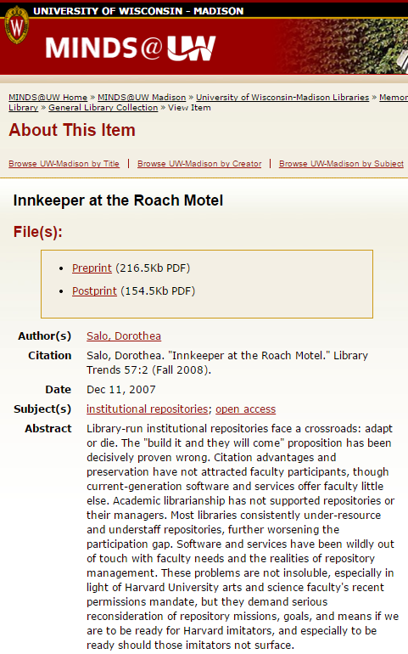
Salo, Dorothea. "Innkeeper at the Roach Motel." Library Trends 57:2 (Fall 2008).
http://minds.wisconsin.edu/handle/1793/22088

Slide 19
Chapter three : the haves and the have nots

Slide 20
The cris
Notes:
Around 2010 a new product started to appear at some Universities: The CRIS. (Common Research Information System).
Broadly speaking A CRIS manages much of the administrative research process. They can often pull in publication output information for external sources such as WoS and Scopus, this helps make adding outputs as easy as possible, though doesn’t include all outputs, especially in some subject areas.

Slide 21
The Haves
A CRIS and other systems which manage publications and research.
Will choose the most appropriate system for storing information.
Other systems often already link outputs to projects, departments and people.
CRIS often provide easy way to add research (harvesting from WoS and Scopus)
Feed in to the IR
Have Nots
Only the IR for holding research outputs.
Need the IR to adapt to meet all metadata and process needs around publications. REF, Funders.
Need to link outputs to funded projects.
IR needs to do things it was not designed to do.
Notes:
As shown by the diagram, a system such as a CRIS will often be connected to the IR. Normally the CRIS feeds publication information into the IR, for items with a full text item. Hence the IR becomes something as it was originally envisaged: open access research on the web.
We shall see in a moment that there is an increasing need to capture and report on information around publication outputs. Universities can be divided into two groups, those with a research system such as a CRIS or otherwise, and those who do not, and hence have to rely on the IR to adapt to the various requirements. It’s important to note these two groups as they will often had different demands on the software and future development.

Slide 22
Chapter four: funders, mandates and compliance

Slide 23
The finch report
“The 'Finch' report - Dame Janet Finch chaired an independent working group on open access. The group's report, published in June 2012, supported the case for open access publishing through a balanced programme of action.
The report recognised the need for different channels to communicate research results, but recommended support for the 'gold' route in particular.”
http://www.hefce.ac.uk/whatwedo/rsrch/rinfrastruct/oa/oa/

Slide 24
The finch report
“Government - The Government accepted all recommendations in the Finch report. In its formal response it has asked the four UK higher education funding bodies and the Research Councils to put the recommendations into practice by working with universities, the research and publishing communities. “
http://www.hefce.ac.uk/whatwedo/rsrch/rinfrastruct/oa/oa/

Slide 25
Implementing rcuk oa policy
How to turn RCUK policy into a University Policy and procedure?
How to allocate the funds? (if any)
How to track and monitor, in particular so we can report our compliance back?
And how to disseminate all those to researchers?
Who allocates? Who authorises? Who checks? Who reports? Who disseminates? Who supports? (who decides all these?)
What data to collect, and where to store it?
Notes:
The was the start of quite a fast process the led to a Government response a month later fully backing the report and tasking RCUK and HEFCE with adopting it. In the same month RCUK announced its new Open Access policy.
The RCUK policy mandated that all peer-reviewed research papers funded by the Research Councils should be published in a OA-compliant journal, with requirements around length of embargo for Green OA and a CC-BY licence for Gold OA. This would apply to any outputs submitted after April 2013.
To support this, RCUK provided funds to a number of Universities (those which receive a certain level of RCUK funding) to pay for the Gold publication.
Universities had a number of issues to grapple with, and with a relatively tight timeline relative to the speed of change in Higher Education.
How to turn RCUK policy into a University Policy and procedure?
How to allocate the funds? (if any!)
How to track and monitor, in particular so we can report our compliance back?
And how to disseminate all those to Researchers?
And how to endure that decisions around where to publish were kept as academic decisions, not those dictated by support services (Library, Research Finance Office) and budgets.
It required the Library and Research Office to work closer together than they had likely ever done before. Libraries had little understanding of Research Financing, Grants and Funders. And Research Officers had less of an understanding around the scholarly publishing process and Open Access.
As well as the larger policy questions for a University, there was the nitty gritty of exactly what was required, developing detailed workflow and looking into how we would record this information for compliance and reporting.
How would we even know if an output has been funded by RCUK? A researcher may have added it to the IR and made it compliant, but how would we know to even include it in our reporting.
And what would we need to report to RCUK? At the time it hadn’t been stated. You can’t collect data that you don’t know you need.

Slide 26
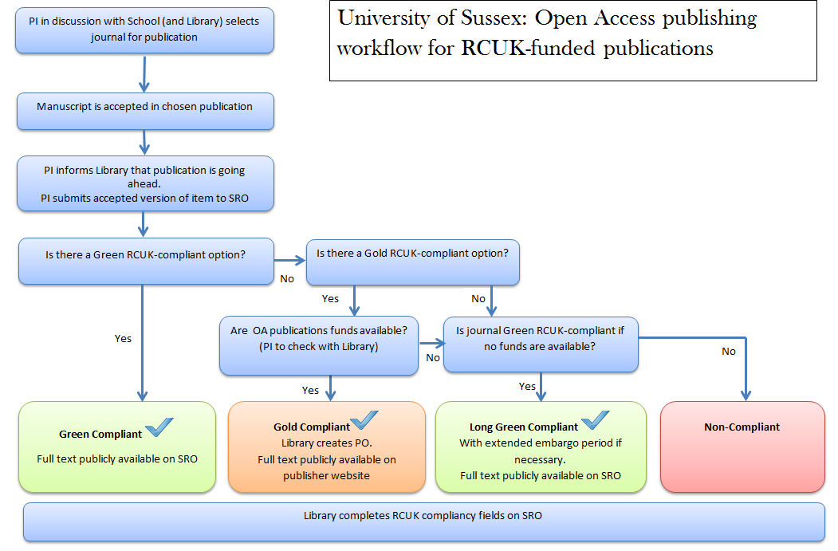
First attempt to map out the decision for green/gold
Notes:
The diagram shows a first attempt at a decision flow chart for deciding green or gold.
In practice, of course, things are much more fluid, and expecting researchers to contact us was somewhat more of an aspiration. It’s more typical that our first contact (if any) with an academic is often at the point that they have committed to pay for Gold and simply want to know how to pay for the thing.

Slide 27
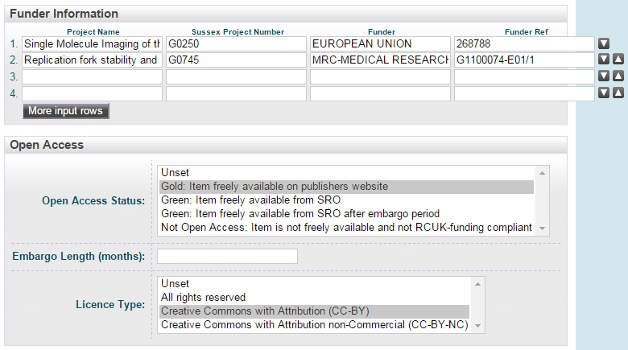
Notes:
At Sussex we added a number of fields to our IR to capture information that would be useful to report to RCUK. Funder information tracks the funders and projects connected to a project. We worked with our IT Services to develop a feed in data into the IR, so that you just have to select a project name and the other fields will be completed. We also had some fields around OA, though these are currently being reviewed.
The funder fields were essential as we need to identify, track and report on outputs which were RCUK funded (and increasingly for other funders as well).

Slide 28
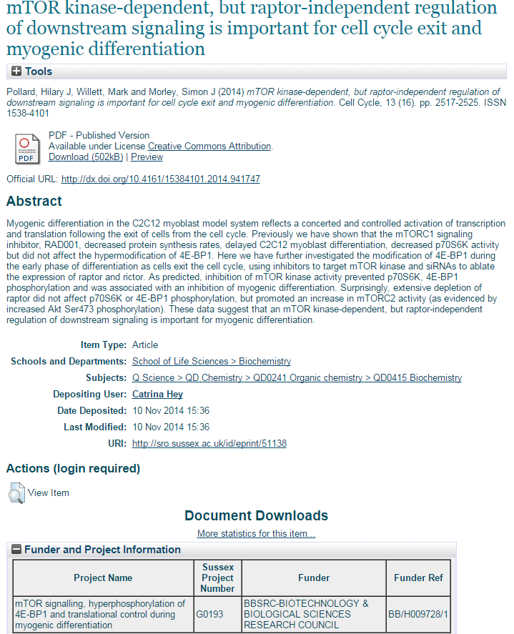

Slide 29
Compliance reporting
The number of peer‐reviewed research papers arising from research council funded research that have been published by researchers within that institution.
Of these research council funded papers, the number that are compliant with the RCUK policy on Open Access by:
a. The gold route
b. The green route.
And the number which have been published in a journal which is not compliant with the RCUK policy on Open Access.
http://www.rcuk.ac.uk/RCUK-prod/assets/documents/documents/ComplianceMonitoring.pdf
Target 45% compliance in the first year
Notes:
The biggest challenge was reporting on non-compliancy. How do you report on those you do not know about? This required a large amount of time to manually search abstract databases (mainly Scopus) for our PIs to look for outputs which fall in this time period. Once found, we needed to check if they were RCUK funded research, and if they were submitted after the 1st April 2013.
Often, we could actually added them to our IR to make them compliant, if the journal’s policy allowed and the author had the right version available. And if not we would count the output as non-compliant.

Slide 30
One: Academics contact us during publication
two: searching for Sussex RCUk- funded work
Normally a little later than we’d like.
Sometimes already committed to Gold
New world for academics, library, publishers and finance systems
Used Scopus and other databases to search for PI at Sussex who have recently published.
If output was from funded research:
Either retrospectively make it green if possible.
Or at least we know it exists and is non-compliant (crucial for reporting)
Time intensive

Slide 31
Mandates : like buses
Europe Horizon 2020
Wellcome Trust
Charities Open Access Fund (COAF)
All with different requirements
And then we have…
RCUK is not alone.
Notes:
Like Buses
RCUK is not alone.
A number of other funders have also put mandates in place in the last 18 months.
Europe has an OA policy for their new Horizon 2020 stream of funding, which places strong emphasis on deposit into an IR.
The Wellcome Trust has a policy that encourages immediate OA or short embargos and CC-BY licensing. It has also, in partnership with a number of other charities, set up a fund (COAF) to help pay for the costs of Open Access.
and then we have the REF...

Slide 32
Post-2014 Ref
Aka REF2020

Slide 33
Ref 2020 Open access
Journal articles and conference papers submitted to the REF 2020 with an acceptance date of 1 April 2016 or later will have to be available as Open Access with a maximum embargo date of 12 or 24 months (depending on subject) after acceptance.
The authors accepted version will need to be deposited into a repository within three months of acceptance for publication. That means choosing a journal that complies, and also implementing it, by uploading the article onto the IR or other repository within three months.
http://www.hefce.ac.uk/media/hefce/content/pubs/2014/201407/HEFCE2014_07.pdf
Notes:
Journal articles and conference papers submitted to the REF 2020 with an acceptance date of 1 April 2016 or later will have to be available as Open Access, with a maximum embargo date of 12 or 24 months (depending on subject) after acceptance.
The author’s accepted version will need to be deposited into a repository within three months of acceptance for publication. That means choosing a journal that complies, and uploading the article onto the IR, or other repository service, within three months.
This is a massive undertaking. The REF potentially applies to all academics, not just those funded by a particular funder.
Ensuring as many as possible comply will be a real challenge, and processes put into place to support this real need to scale.
The repercussions of not doing so are large: the REF dictates the block Research Grant for a University; it can make or break a University in terms of Research.
Universities can’t start to prepare for the REF a couple of years before its deadline, as for some has been the case in the past. By that time, it will be too late to deposit the research into a repository within three months of acceptance.
Universities are really only just starting to address how to respond to the REF Open Access requirements. It will require a change of culture across the institution. It will also require a notable increase in staffing resource to support and inform academics, and to supplement and check the required extra metadata.

Slide 34
Research Data
Broadly: funders require researchers to plan the management of their data, and to make it accessible.
Encouraging making it Open, though mostly not yet mandated.
Notes:
Another Funder requirement is around Research Data. Typically, funders are requiring researchers and sometimes institutions to have research data management plans, and are encouraging the sharing of data and making it open.

Slide 35
Research data
Existing Repository
Separate data repository
External service
Subject data Repository
Data Registry
Local storage
Cloud
Storage
Specialist Archival system
Notes:
There are a number of different approaches here. A University can use its existing IR, can implement a separate repository just for data, or use an external service. There are also different storage options, such as traditional local storage, ‘cloud’ based storage (Amazon S3) and specialist archival systems. One example is Loughborough, who have recently announced they will use Figshare as a frontend and as a backend for storage.

Slide 36
the issues

Slide 37
The issues
Policy (with others); develop procedures; create websites and support materials; engage with academics; report to managers; look in to changes in to the IR; support; check and add metadata; search for publications we don’t know about
Staffing has (mostly) not adapted to these new requirements, let along those in the pipeline (REF) – staff still doing the same jobs before this supporting researchers.
Software hasn’t adapted. UK specific issues; software is global. Don’t want to re-invent the wheel, especially with risk of getting it wrong.
Doesn’t fit naturally in to University structure. Requires all Schools and researchers to comply
Notes:
Also we are facing increasing demands to provide management reporting, and the need to integrate with the systems - the latter partly due to the IR not containing all the information we need to report on.

Slide 38
31 potential extra fields to Eprints
https://docs.google.com/spreadsheets/d/1dg_3bN9CNzLf5OQUefonddBpsYJzdXFfO1Q9W8oi3F8/edit#gid=816106069
Notes:
http://e2eoa.org/

Slide 39
Chapter five : help on the horizon

Slide 40
Notes:
Rioxx - Rioxx is a metadata profile. The plan is, I think, for IRs to expose data about their records according to this profile, and funders will harvest this information to track compliance and for their own reporting. Part of this work will include plugins for the major repositories. Essentially, by complying with Rioxx and its requirements, we are complying with the funder’s requirements. However, we need to make sure the data in the IR is stored and entered in such a way that it can be exposed in the correct manner. http://www.rioxx.net/

Slide 41
Notes:
Jisc pathfinder projects : e2e: this project specifies the fields that need to be added to Eprints to help comply with the different funders. It should also result in a plugin or similar to the eprints software which will create the required fields. At the moment there are 31 fields that have been identified to ensure we can record all the information needed to comply and report for the different funders. That’s a lot of fields and raises serious questions around how we can support so many. http://e2eoa.org/

Slide 42
JISC monitor
Jisc Monitor is a 12-month project exploring whether a user-centred, shared national service could potentially help institutions to manage their OA activity effectively. It complements UK projects such as Open Mirror, and others by HEFCE and the research councils, attempting to scope and understand the issues around OA reporting and work up some practical solutions.
http://www.jisc.ac.uk/blog/monitoring-and-shaping-the-transition-to-open-access-05-nov-2014

Slide 43
JISC Monitor

Slide 44
IRUS
Notes:
IRUS : Provides COUNTER style reports of downloads of full text. Anyone who has worked with web statistics will know the importance of reliable numbers that filter much of the ‘noise’ from web reports. And IRUS reports not just on our own data but also of other contributing IRs, allowing us to compare with our peers. http://irus.mimas.ac.uk/

Slide 45
Funders
RIOXX
Discovery
Repository
E2e fields
IRUS
JISC Monitor
Notes:
This is how I model the different projects interacting with each other. I see the fields created by e2e as key, as they will hold the information that RIOXX will make available for funders, and which will be populated in part by information found (I think) by JISC Monitor.

Slide 46
Summary
Institutional Repositories need to adapt to new requirements and demands. They haven’t yet.
However, those with alternative systems such as a CRIS, may not find this to be true.
Universities have not yet put in place the procedures and resources to support these new requirements. Some have not even started to plan for this.
Many Universities considering how to support open data, and/or a data registry
New services may help with these new requirements
Mandates, as well as pushing the IR in new directions, may help it to go back to its OA roots
(with thanks to ukcorr for useful comments)
Notes:
IRs need to adapt to a new world of funder mandates and reporting and Universities need to adapt and increase their staffing to support the IR, as it takes on a larger and more important role. Though this will be less true for HEI’s with other systems.
The REF in particular will require a change in how Universities operate, something most Universities have barely begun to address.
The Library finds itself in a new role. While the Library has always played an important part in campus life, it now finds itself providing critical reporting and processes which the financial (and research reputation) future of the institution may depend on. Making a mistake in a catalogue record is very different to making a mistake in a REF submission.
Meanwhile, Universities are looking at how to support open data and the sharing of data and there are services being developed to help us in this new world.
Finally, funder mandates, especially in combination of CRIS and other Research systems, may actually bring the IR in full circle back to its OA roots.

Slide 47
Question time
@chriskeene
c.j.keene@sussex.ac.uk
Notes:
With thanks to UKCORR mailing list for useful thoughts on some of the points raised here.
Thanks to Jane Harvell and Joanna Ball for useful comments and, in the case of the former, the use of their office for the webinar.
Thanks to Helen Webb for answering lots of questions when preparing this
Thanks to Eleanor Craig for proof reading my notes.

